Slide 1

Network Traffic Classification
CSCI 434
Andre Tran, Colton Turner, Eli Jensen, Marshall Wright

Slide 2




Objective
Our objective is to build machine learning models that can automatically classify the source of network traffic without access to the source and destination IPs or the packet payloads.
These machine learning models will be built using other features extracted from the packets sent over the network as well as the flow of the packets over time

Slide 3




Data Collection
For data collection we collected packet samples from 4 websites and apps using wireshark
These websites included single download, continuous download, continuous upload, and continuous upload and download.
We collected the protocol, length of the packet, packet info, time since last packet and flow
Overall about collected 30-60 seconds of packet information for each website and app
Websites used:
Bing
Amazon
Discord
Minecraft

Slide 4
Dataset Details
Example Data Samples
Protocol | Length | Info | Time Delta | Label
TCP | 1514 | 3 | 0.0001ms | Bing
TCP | 56 | 3 | 0.0045ms | Minecraft
UDP | 233 | 1 | 0.0175ms | Discord
TCP | 1494 | 3 | 0.0014ms | Amazon
Dataset Size
Labels | Number of Individual Packets
Discord | 5750
Bing | 2850
Amazon | 1400
Minecraft | 4950
Total | 14951
Extracted Features
Features | Details
Protocol | E.g., TCP, UDP, TLSv1.3…
Length | The total size in bytes of each packet
Info | The mapping of similar sections accessible in the info data of a packet
Time Delta | The time since last received packet in flow

Slide 5
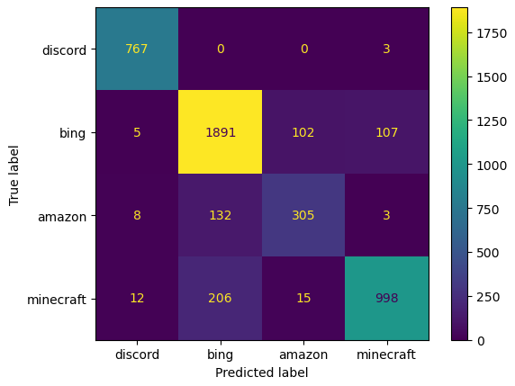
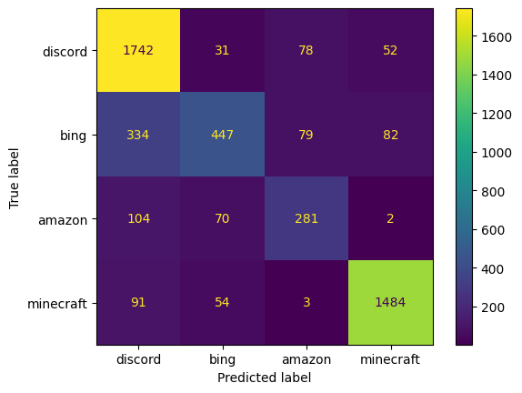


Basic ML Model Results
K-Nearest Neighbor (KNN): operates by finding the k nearest neighbors to a given data point, and takes a majority vote to classify the point
Decision Tree: each node in the tree specifies a test on an attribute, each branch descending from that node corresponds to one of the possible values for that attribute.
Random Forest: an ensemble learning method used for classification and regression. It builds multiple decision trees and merges them together to get a more accurate and stable prediction.
Model | Accuracy | Macro F1 Score
KNN | 0.87 | 0.85
Decision Tree | 0.80 | 0.73
Random Forest | 0.80 | 0.74
KNN
RFC
DTC

Slide 6
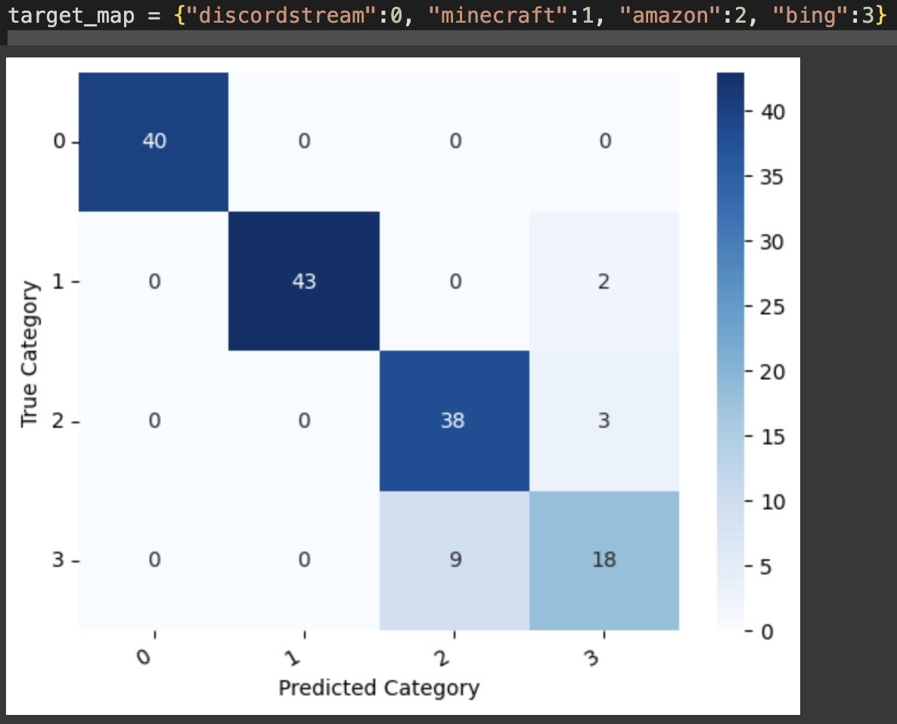
Advanced ML Model (LSTM)
Dataset Size
(Flow Slices 20 packets)
Input Features | Details
Protocol | E.g., TCP, UDP, TLSv1.3…
Length | The total size in bytes of each packet
Info | The mapping of similar sections accessible in the info data of a packet
Time Delta | The time since last received packet in flow
IP (user or site) | 1 or 0 for user or site, no information about actual IP address
Labels | Number of Slices
Discord | 173
Bing | 146
Amazon | 196
Minecraft | 250
Total | 765
LSTM: a type of recurrent neural network (RNN) that is designed to address the vanishing gradient problem, which is a common issue with RNNs that use a cell state to store information about past inputs. This cell state is updated at each step of the network, and the network uses it to make predictions about the current input.
Capture slices to balance data collection load and desire for # of samples
LSTM model capable of learning order dependence for time series data
Results
Model | Accuracy | Macro F1 Score
LSTM | 0.91 | 0.89

